Slide 1
SQL project for data visualization
Visualization through queries for Chinook database
Submitted by: Bhavita Thakore

Slide 2
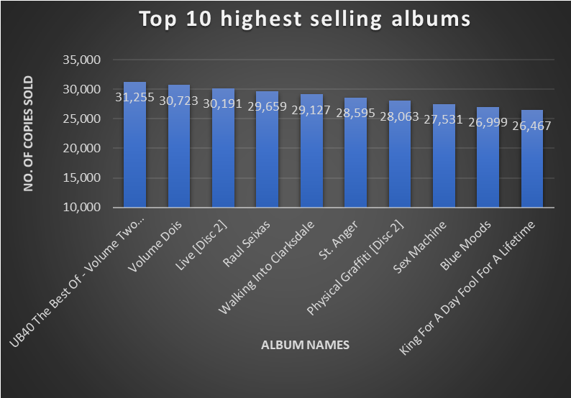
Query – 1 - What are the top 10 highest selling albums?
UB40 The Best Of Volume Two has the major amount of copies sold ranking at the top, while King For A Day Fool For A Lifetime is ranking the tenth on the list.
All the album on top 10 list has copies sold over 26,000 having almost similar amount of difference in their copies sold compare to each other which is around little over 500 copies.

Slide 3
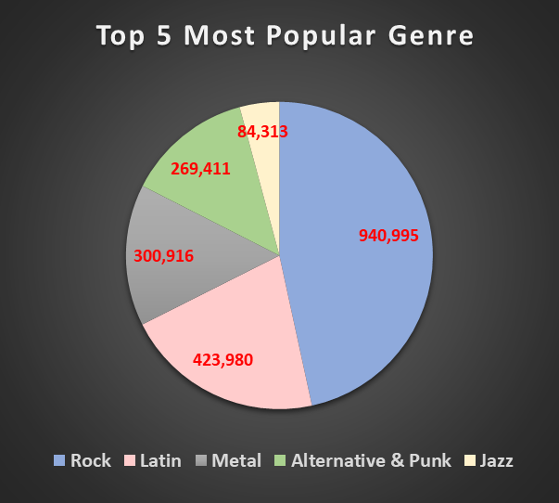
Query – 2 – What are top 5 most popular Genre?
Evidently Rock is the most popular genre of all with having nearly a million track copies sold. Jazz ranks the fifth in the list of popularity with having 84,313 track copies sold.
The difference of copies being sold between Rock and Jazz is more than 856, 682 which shows that even though Jazz has made a place in top 5 popular genre list, it is not quite in demand compare to other genres in the list.

Slide 4
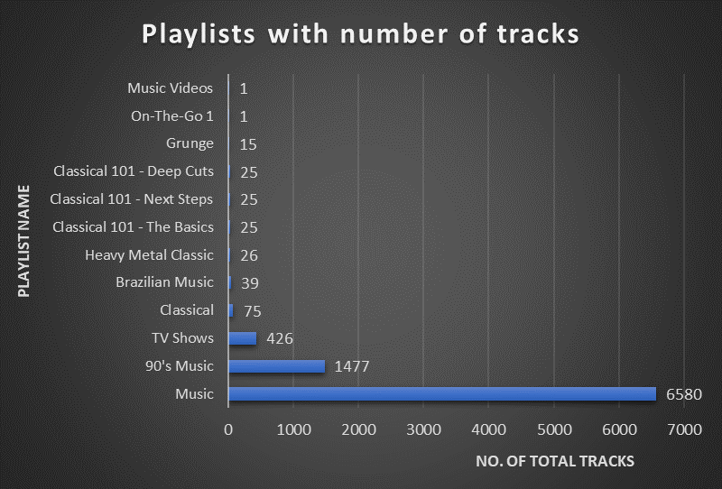
Query – 3 – which playlist has the most number of tracks?
Clearly Music playlist has the most number of tracks that is 6580.
The range of total number of tracks among different playlists is quite big. The lowest number of tracks in a playlist is only 1. This indicates data discrepancies between the tables that contains playlist information

Slide 5
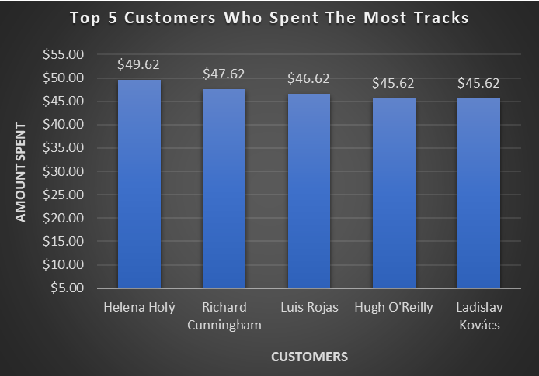
Query – 4 – Name the top 5 customers who spend the most on tracks
Helena Holý has spent the most on tracks which is $49.62.
Hugh O'Reilly and Ladislav Kovács both has spent $45.62 on the tracks.
Among all top 5 customer, the average amount spent on the tracks is $47.02 which very close to the amount spent by the 1st and 5th ranked customer.

